Slide 1

COMP-3220 GROUP PROJECT

Slide 2
Business & Vision
The vision of our project is to develop and ODP (Open Data Platform) to complete the ability to collect, manage and distribute data.
This ensures the visitors to the city of Windsor’s website will have a dynamic view of the available data. The main goal of the application is to ensure the city has provides data to its residents which can increase opportunities of growth for the city.

Slide 3
Objectives
Provide user of the database with a more elaborate representation of the data.
Easier data management is one of the key objectives.
Assist the City of Windsor to improve the quality of their open data portal.

Slide 4
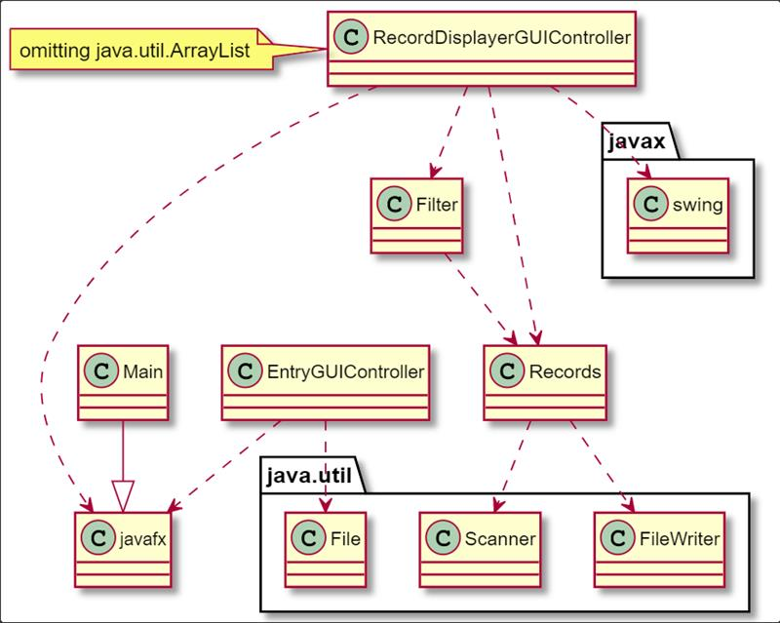
System-Architcture

Slide 5
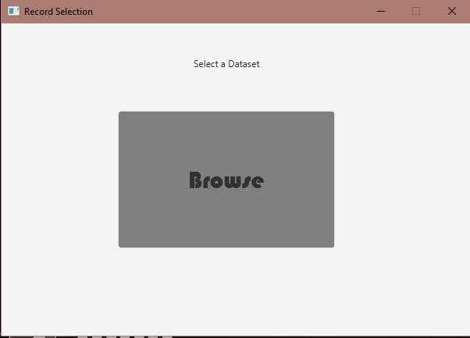
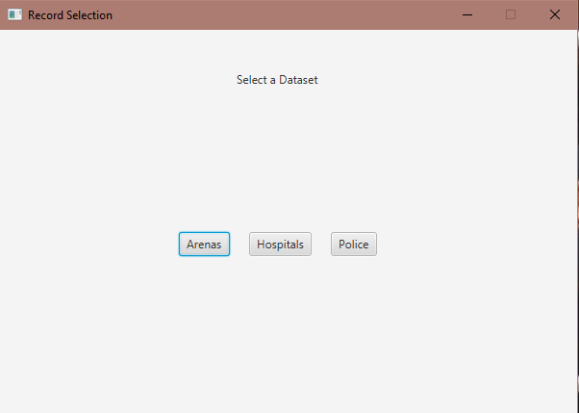
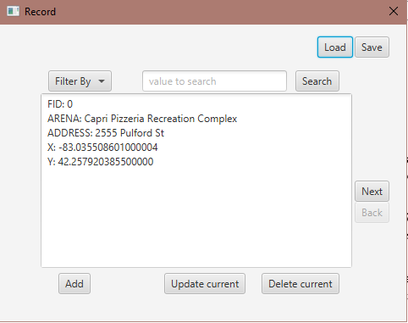
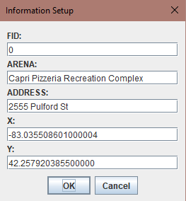
TESTING

Slide 6
DRAWBACKS
One of the drawback of the application is it only runs offline, the online version is future objective.
Licensing of paid software to be used in the application.
Dataset that will be used by the application must be present on the user’s system.

Slide 7
Summary
Inception Phase :- Collaborative
Elaboration Phase I :- The elaboration phase workload was split between two groups within the main group, this ensured each team member had another team member to assist them.
Elaboration Phase II :- Implementation of the application and the documentation was done by assigning responsibilities to each member. A peer review was conducted to ensure the task completed by individual members was up to standard.

Slide 8
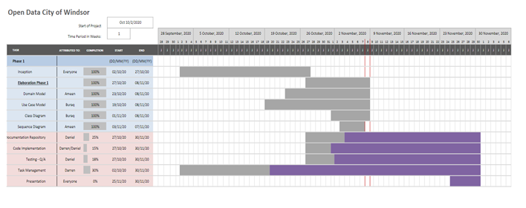
Communication & Team Planning

Slide 9
Code Repository
Documentation and instructions on application usage have been mentioned in the code repository.
https://github.com/ameenalkaisi/Open-Data-Portal-Project

